Slide 1
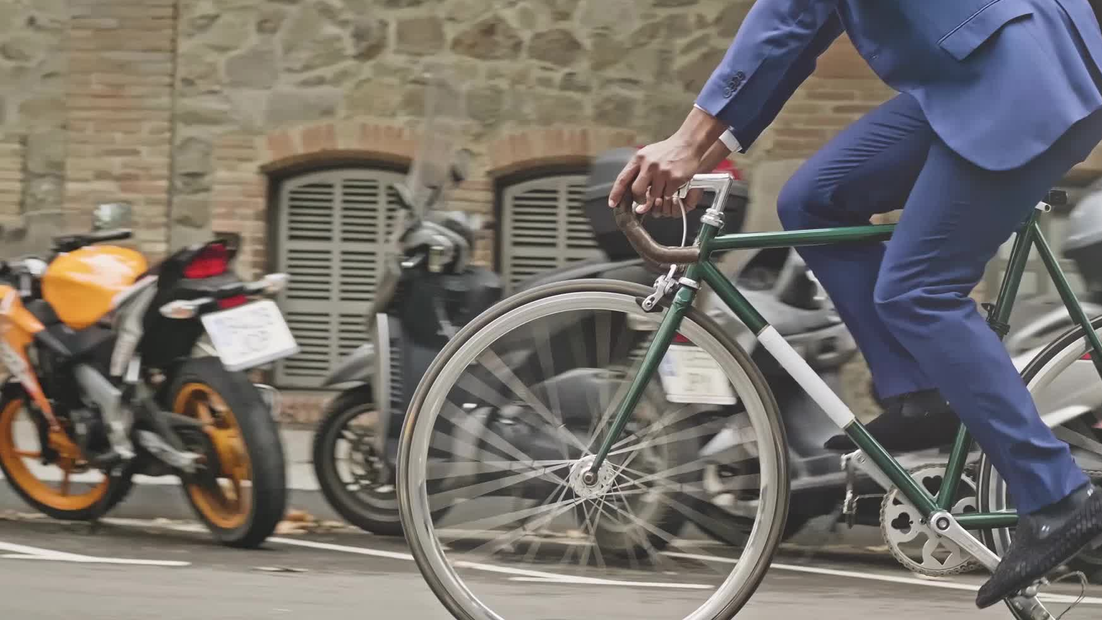
Cyclistic bike-share analysis
Author: Lale Mulati
Date: 2022-08-16

Slide 2
Cyclistic bike-share program
Launched at 2016; total bicycles 5,824; has total 692 stations only across the Chicago, US.
Pricing plan: single-ride pass; full-day pass; annual membership
Promote: Email, social media, other channels.
Goal: Convert casual riders into membership.

Slide 3
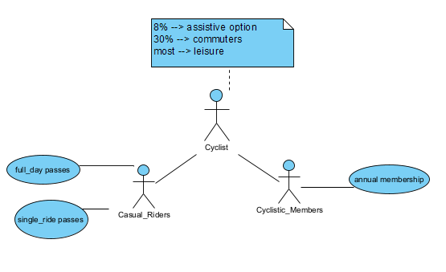
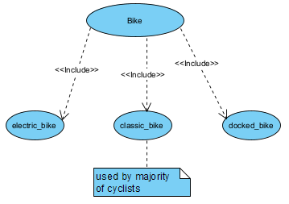
Objects:

Slide 4

Business Task
How do annual members and casual riders use Cyclistic bikes differently?

Slide 5
Hypothesis: (What elements affects different members use Cyclistic differently?)
Time
Ride duration
Bike type

Slide 6
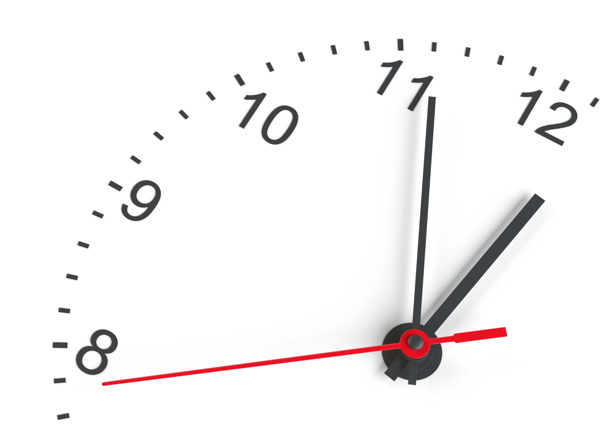
Time
Rides per Hour
Rides per Day
Rides per Month

Slide 7
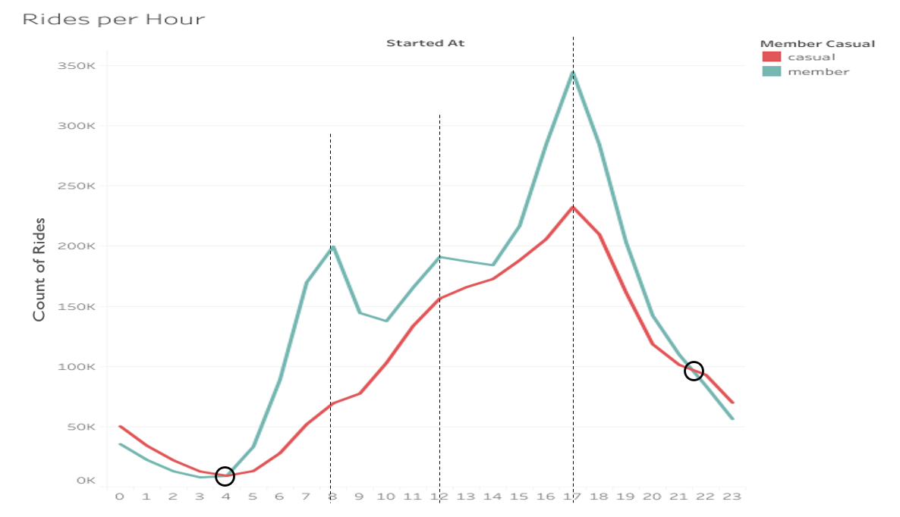

Slide 8
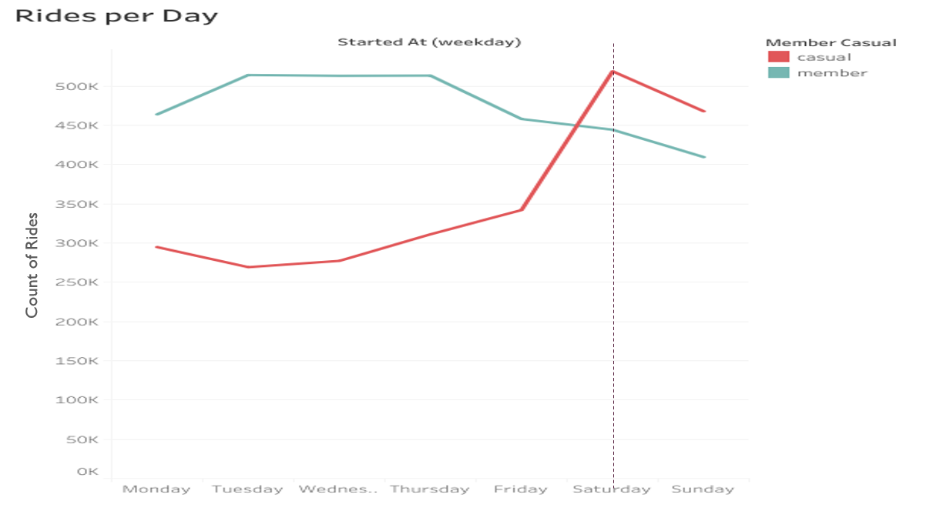

Slide 9
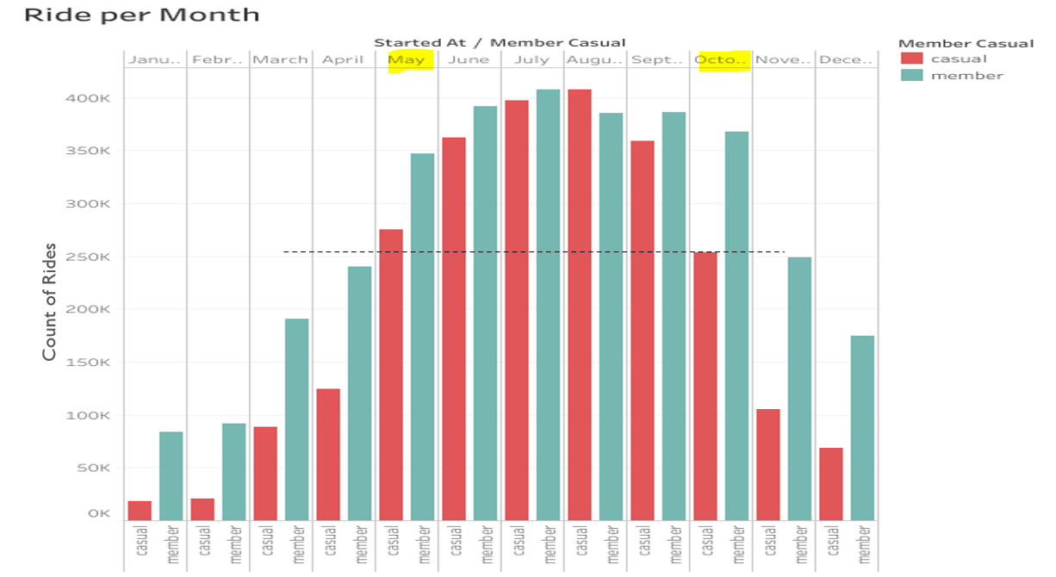

Slide 10
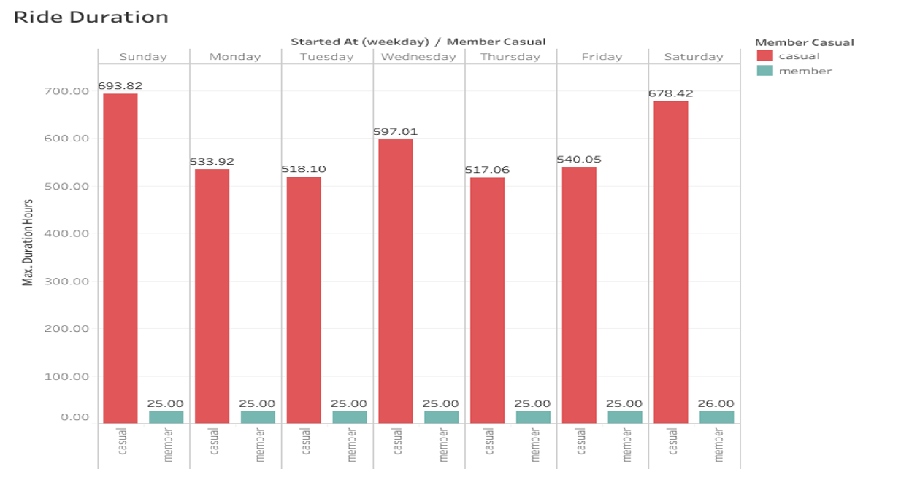


Slide 11
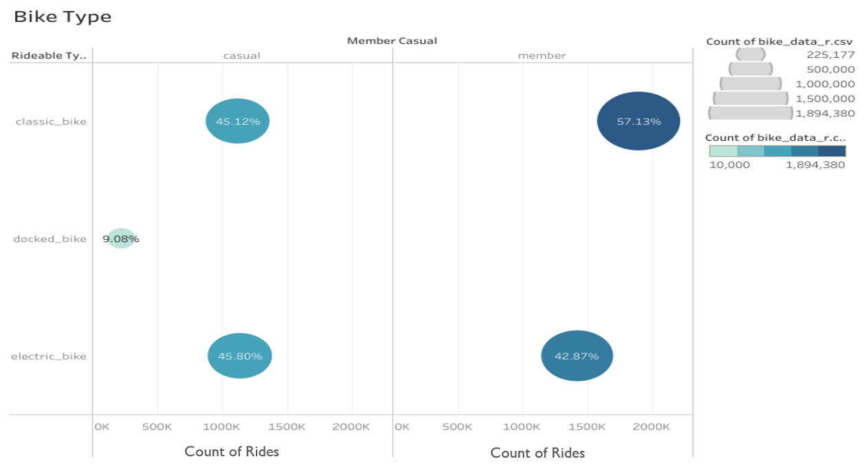


Slide 12
Key Findings & Summary:
Annual Members:
Main Client Type: Commuters; Students
Highly active during weekdays, and peak hours (8 am, noon, 5 pm).
Never used ducked-bike.
Steady ride duration. Maximum ride-duration didn’t exceed 26 h on any days.
Ride frequency is comparatively steady based on season changes.

Slide 13
Key Findings & Summary:
Casual Riders:
Main Client Type: Tourists; not familiar with routes
More active than annual members during the nighttime hours. (10 pm – 4 am)
Number of rides dramatically increase during summer season ( May – October).
Prefer to ride during weekends compare to weekdays.
Although weekdays comparably low rides, weekdays peak hours same as annual members. (8 am, noon, 5 pm)
Barely use on Jan and Feb.
Extremely Long ride-duration.

Slide 14
Recommendations:
For single-ride customers, charge them more during nighttime hours (11 pm to 4 am). And high peak hours. And send them an email how much money they could save if they purchase annual membership.
Target regular customers who’s ride-duration is more than 25 hrs, and send them email about how much money they paid extra than annual membership.
Charge little extra for ducked-bike.
Highlight the benefits of Annual Membership, share it through social media and email.
Convince
Eco-friendly
Healthy (calory burn score)

Slide 15
Resources:
Previous 12 months of Cyclistic trip data (Aug, 2021 – July, 2022)

Slide 16
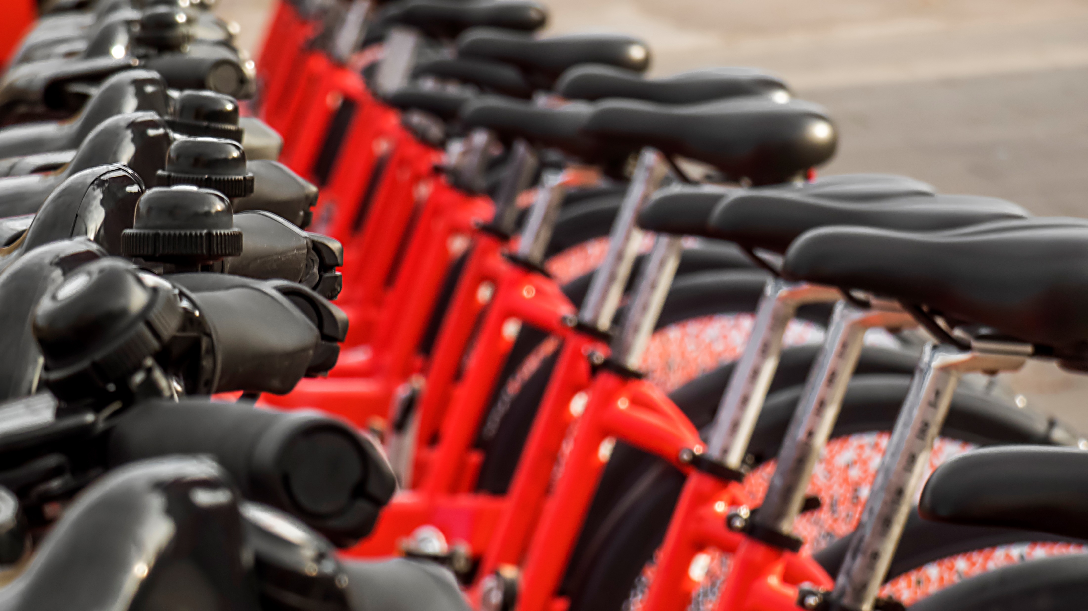
Q & A

